Slide 1




nothing
goo.gl/UgfVfi
How to Lead Students in the Literature Search
Dr. Christina O'Malley
Dr. Patrycja Krakowiak
Washington DC, October 1-2, 2016
Notes:
45 min SESSION

Slide 2
SUMMARY
Our Journeys
  Chrissy and Patricia
Steps to a Literature Search
  IDEAS and KNOWLEDGE
  REFERENCES and SEARCHES
  OUTLINES and CONNECTIONS
Common Mistakes and Tips
COMMENTS!

Slide 3
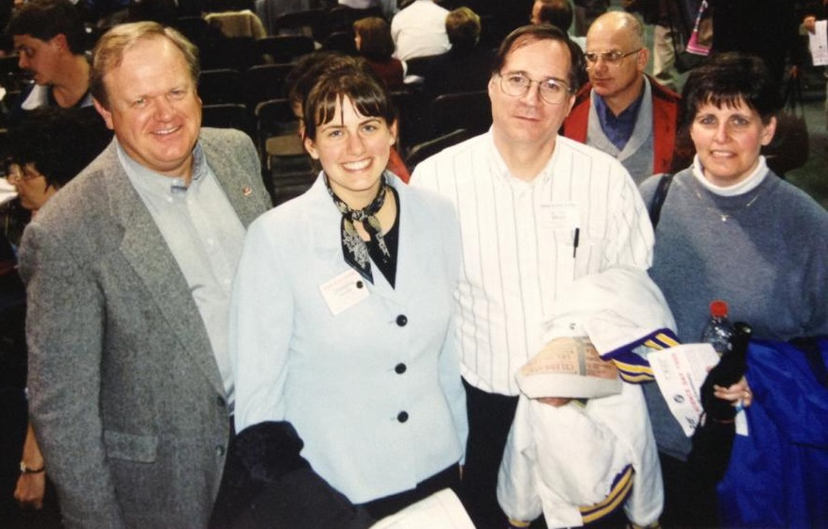
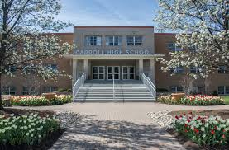
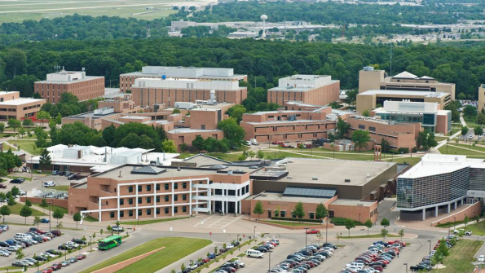
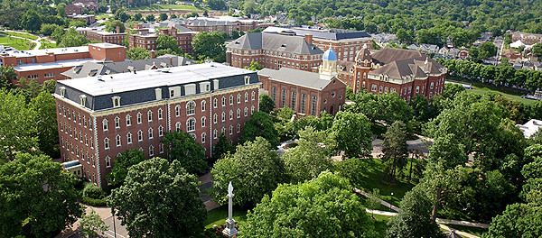
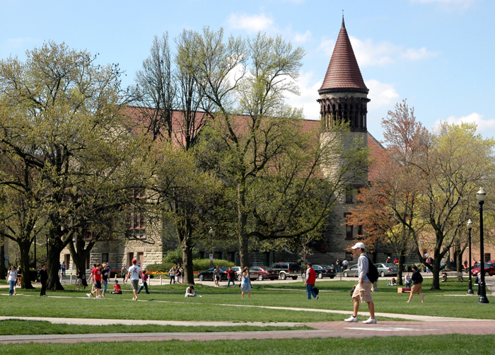
Our
Journeys
Dr. Christina O'Malley
(Chrissy)
Science Fair / ISEF
Carroll High School
AP Bio, Honors Chem, Physics
Wright State BS, BS, MST
Biology, Chemistry, Earth Science
University of Dayton MSEd
License, Secondary Science Ed
Ohio State MS, PhD
Geology/Paleontology

Slide 4
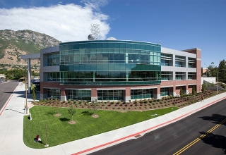
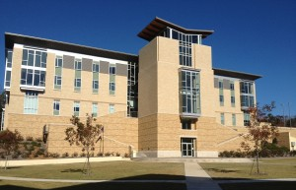
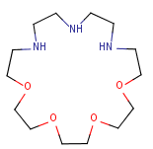

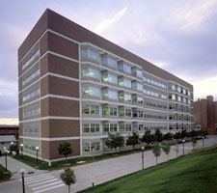

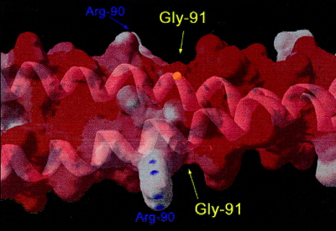
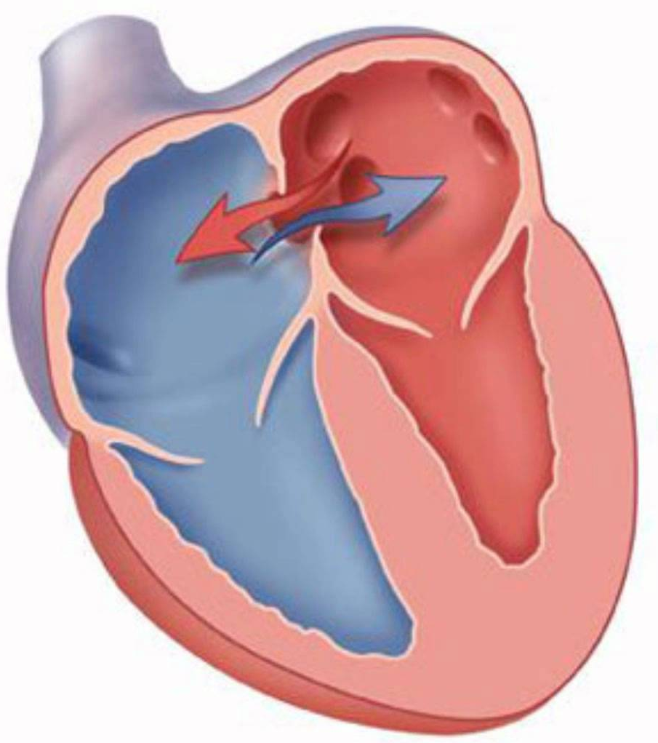
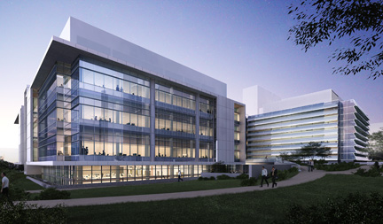
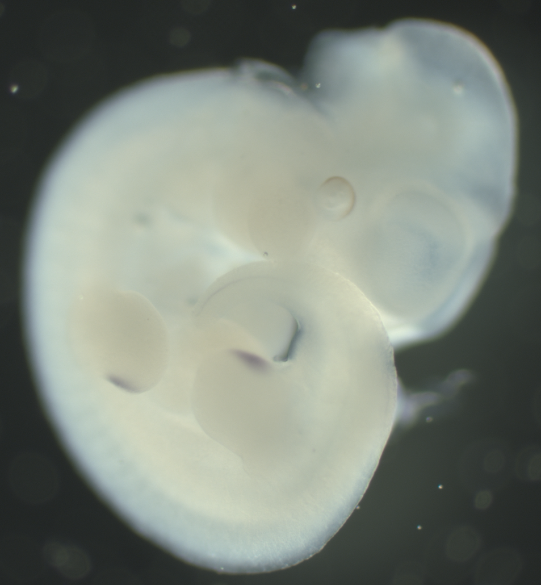
Our
Journeys
BS
Teacher
Chemistry, emphasis
Molecular Biology (BYU)
Dr. Patrycja Krakowiak
(Patricia)
Genetics, Molecular Bio,
A & P, AP Bio (ASMSA)
PhD
Assistant Professor
Human Genetics (UU)
Arkansas Center for Birth Defects
Research and Prevention (UAMS)
Post-doc
Child Health and Human Development (NIH)
Sc5d -/-

Slide 5

STEPS
Brainstorm research IDEAS
Search for REFERENCES
Prepare an OUTLINE
Fill in TRANSITIONS
Evaluate FEASIBILITY

Slide 6
BRAINSTORMING
Brainstorm
(start with a few examples or topic areas, school database)
  PADLET: https://padlet.com/krakowiakp/SRTDC2016
Find out enough about a topic to evaluate it
Choose the MOST:
  Exciting
  Feasible
  Novel

Slide 7
LEARNING
Search for general information
  Importance
  Vocabulary
  Timeline
Start Broadly to develop Working Knowledge
  Yes, even Google and Wikipedia are useful (NOT as references)
  Scientific American
  NIH and University websites
  Start with reviews to build vocabulary and familiarity
Describe the topic in a single paragraph
  How does your question fit into what is already known about the topic
  What is not known yet, define your “problem/question”
  Why is this project worthwhile:
  SO WHAT?

Slide 8
SEARCHING
Identify NOUNS
  Select Keywords (at least 4)
  Find synonyms
  Consider broader terms
  Use related terms
Full-text vs. Keyword searching
Start with at least 50 possible references (reviews)
Identify ~ 10 peer reviewed journal articles to read
Additional may be needed (reference sections of other papers)
Narrow or broaden search using
  Boolean Operators:
    and, not, or
  Specific Phrasing:
    “order matters” vs. order matters
  Grouping:
    (human and Homo sapiens) not (mouse or Mus musculus)
  Truncation:
    genetic* = genetic, genetics, genetically
Notes:
Verbs, adverbs, adjectives, and prepositions make weak search terms: they are present in many resources unrelated to the initial search.

Slide 9
USING DATABASES
DIG IN:
  Books:
    Your library
    Google Books
    WorldCat
    Interlibrary Loan
  Articles from peer-reviewed journals:
    Types: full-text, abstracts, free
    Google Scholar (broad)
    Patents: Espacenet, Google Patents, USPTO (specificity, novelty)
    PubMed: (specific) http://www.ncbi.nlm.nih.gov/pubmed
PubMed (narrow to ~200)
  Use various search terms AND Boolean operators
  Use filters
    Review
    Free Full text (not always useful)
    Dates (maybe 10 years)
    Languages (maybe English)
  Find promising title/abstract
  Copy URL + open in new tab
  Click on similar articles (reviews) on right
Notes:
Verbs, adverbs, adjectives, and prepositions make weak search terms: they are present in many resources unrelated to the initial search.

Slide 10
USING DATABASES
Google Scholar
  Use various search terms (author, keywords) AND Boolean operators
  Can search Patents
  Sort by year for most recent
  Use “my library” to save references
  Follow links to pdf (for some)
  Results too specific?
  Try REFERENCES for related topics
  Results to general?
  Try CITED BY to see who else used this paper
  Don’t know how to cite?
  Click CITE and copy or save the citation
Notes:
Verbs, adverbs, adjectives, and prepositions make weak search terms: they are present in many resources unrelated to the initial search.

Slide 11
FORMATS
CSE (scientific writing)
  The University of Wisconsin’s Writing Center: https://writing.wisc.edu/Handbook/DocCSE_CitationSystems.html
APA (scientific writing)
  American Psychological Association: http://www.apastyle.org/learn/tutorials/basics-tutorial.aspx
MLA (language, literature and cultural writing)
  Purdue Online Writing Lab: https://owl.english.purdue.edu/owl/resource/747/01/
Chicago (history)
  The Chicago Manual of Style Online: http://www.chicagomanualofstyle.org/home.html
Lastname, Firstname Initial. Year. Article title. Abbreviated journal title. Volume(issue):pages.
Lastname, Firstname Initial(s). (Year). Article title. Journal Title, Volume, page range.
Lastname, Firstname. ”Article Title.” Journal Title Volume. Issue (Year): pages. Medium of publication.
Lastname, Firstname. “Article Title.” Journal Title Volume (Year): page range.
Notes:
CSE: Council of Science Editors (Documentation)
APA: American Psychological Association
MLA: Modern Language Association
Chicago/Turabian

Slide 12
OUTLINE
While reading papers
  Highlight
  (2-colors: main ideas + questions)
  Take notes in the margins
  Organize
    Headings
      create as you encounter new main ideas in papers
      can be out of order
      use figures
    Keep track
      under each heading write down author, pg# and paragraph # where you found supporting details
After reading papers
  Order and prioritize the headings
  Some headings will become subheadings
  Add detail under each heading/subheading from appropriate papers
  Think about connecting various ideas (transitions)
Notes:
CEO Requires an annotated bibliography

Slide 13
COMMON ERRORS
Not feasible
(time, cost, equipment)
Not novel
Too specific
Too general
Disorganized
Incomplete background
Irrelevant information
Too many quotes
Poor transitions

Slide 14
TIPS
Incorporate process into other classes
  TOPIC paragraph
  REFERENCES possible
  ABSTRACTS chosen
  PAPERS highlighted
  NOTES taken
  OUTLINE order
  DRAFT for peer review
  FINAL review manuscript

Slide 15
Comments and other IDEAS
2.
1.
4.
3.

Slide 16
CONCLUSION
BENEFITS
  EXPOSES students to latest scientific research and content
  Helps students become ACCUSTOMED to
    Searching
    Reading
    Understanding
  peer-reviewed scientific articles
  TEACHES how to organize and communicate acquired knowledge
  EXCITES and EMPOWERS (builds upon passions)
CHALLENGES
  Getting started is OVERWHELMING
  Developing working knowledge takes TIME
  Assuring completeness is TRICKY
  Limiting Breadth/Depth of content is DIFFICULT
  Understanding limitations and feasibility require MATURITY and GUIDANCE
  Organizing ideas is TOUGH
  Writing complete/coherent sentences and paragraphs takes RE-WRITING

